Slide 1
COMP 2710 Software Construction
Testing and Debugging
Dr. Xiao Qin
Auburn University
http://www.eng.auburn.edu/~xqin
xqin@auburn.edu
Fall, 2012
These slides are adapted from notes by Dr. Walter Savitch (UCSD)
Notes:
Note: (1) Limit the number of global variables. See home:/comp2710/samples/globalVar.cpp
See sp’10 Lec12c-Debugging.
Sp’12 Lec06b

Slide 2
Debugging Statements
Can be turned off
Need to have meaning
Copyright © 2008 Pearson Addison-Wesley. All rights reserved.
4-<number>

Slide 3
Testing and Debugging Functions
Many methods:
  Lots of cout statements
    In calls and definitions
    Used to "trace" execution
  Compiler Debugger
    Environment-dependent
  assert Macro
    Early termination as needed
  Stubs and drivers
    Incremental development
Copyright © 2008 Pearson Addison-Wesley. All rights reserved.
4-<number>

Slide 4
The assert Macro
Assertion: a true or false statement
Used to document and check correctness
  Preconditions & Postconditions
    Typical assert use: confirm their validity
  Syntax:
  assert(<assert_condition>);
    No return value
    Evaluates assert_condition
    Terminates if false, continues if true
Predefined in library <cassert>
  Macros used similarly as functions
Copyright © 2008 Pearson Addison-Wesley. All rights reserved.
4-<number>

Slide 5
An assert Macro Example
Given Function Declaration:
void computeCoin( int coinValue,
int& number,
int& amountLeft);
//Precondition: 0 < coinValue < 100
0 <= amountLeft <100
//Postcondition: number set to max. number
of coins
Check precondition:
  assert ((0 < currentCoin) && (currentCoin < 100)
  && (0 <= currentAmountLeft) && (currentAmountLeft < 100));
  If precondition not satisfied → condition is false → program execution terminates!
Copyright © 2008 Pearson Addison-Wesley. All rights reserved.
4-<number>

Slide 6
An assert Macro Example Cont’d
Useful in debugging
Stops execution so problem can
be investigated
Copyright © 2008 Pearson Addison-Wesley. All rights reserved.
4-<number>

Slide 7
assert On/Off
Preprocessor provides means
#define NDEBUG
#include <cassert>
Add "#define" line before #include line
  Turns OFF all assertions throughout
  program
Remove "#define" line (or comment out)
  Turns assertions back on
Copyright © 2008 Pearson Addison-Wesley. All rights reserved.
4-<number>

Slide 8
Stubs and Drivers
Separate compilation units
  Each function designed, coded, tested
  separately
  Ensures validity of each unit
  Divide & Conquer
    Transforms one big task → smaller,
    manageable tasks
But how to test independently?
  Driver programs
Copyright © 2008 Pearson Addison-Wesley. All rights reserved.
4-<number>

Slide 9
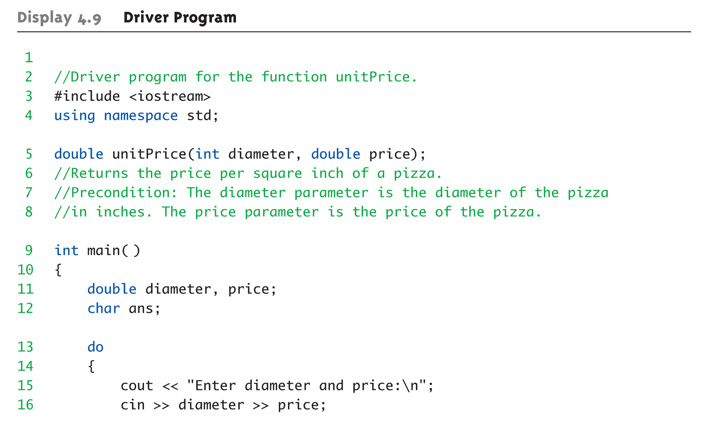
Driver Program Example:
Display 4.9 Driver Program (1 of 3)
Copyright © 2008 Pearson Addison-Wesley. All rights reserved.
4-<number>

Slide 10
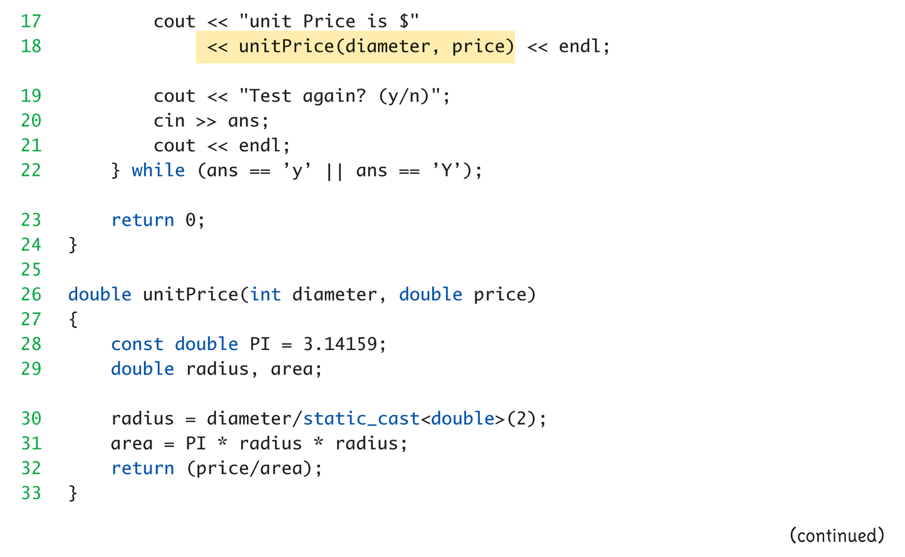
Driver Program Example:
Display 4.9 Driver Program (2 of 3)
Copyright © 2008 Pearson Addison-Wesley. All rights reserved.
4-<number>

Slide 11
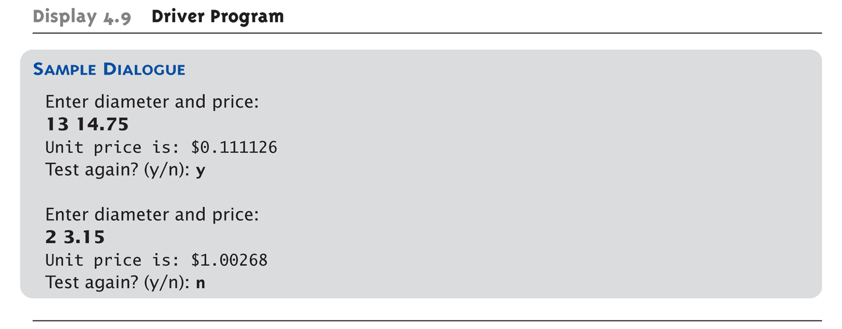
Driver Program Example:
Display 4.9 Driver Program (3 of 3)
Copyright © 2008 Pearson Addison-Wesley. All rights reserved.
4-<number>

Slide 12
Stubs
Develop incrementally
Write "big-picture" functions first
  Low-level functions last
  "Stub-out" functions until implementation
  Example:
  double unitPrice(int diameter, double price)
  {
  return (9.99); // not valid, but noticeably
  // a "temporary" value
  }
  Calls to function will still "work"
Copyright © 2008 Pearson Addison-Wesley. All rights reserved.
4-<number>

Slide 13
Fundamental Testing Rule
To write "correct" programs
Minimize errors, "bugs"
Ensure validity of data
  Test every function in a program where every other function has already been
  fully tested and debugged
  Avoids "error-cascading" &
  conflicting results
Copyright © 2008 Pearson Addison-Wesley. All rights reserved.
4-<number>

Slide 14
Summary
Multiple definitions of same function name
possible: called overloading
Default arguments allow function call to
"omit" some or all arguments in list
  If not provided → default values assigned
assert macro initiates program
termination if assertions fail
Functions should be tested independently
  As separate compilation units, with drivers
Copyright © 2008 Pearson Addison-Wesley. All rights reserved.
4-<number>

